Slide 1
CN:CST31209 : Deep Learning and Big Data Intelligence
JING WEN
Spring 2022
Lecture 2:Introduction to Deep Learning

Slide 2
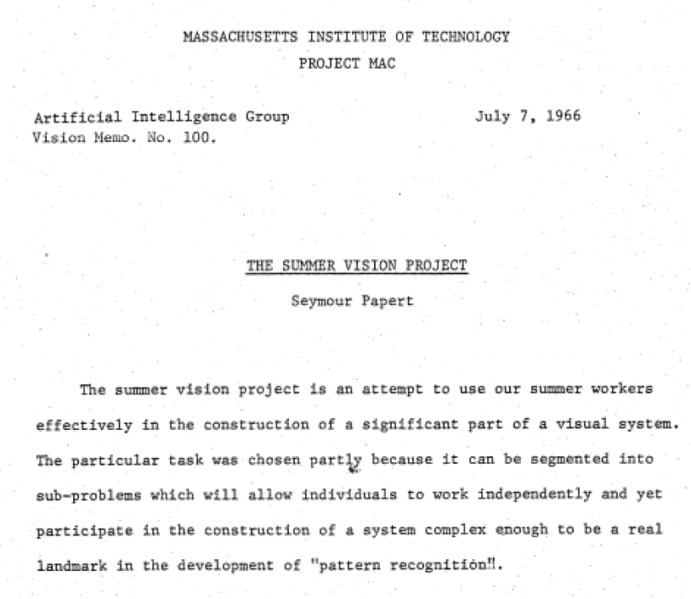
Computer Vision – a brief history
Notes:
Computer vision, a good challenge for a summer project

Slide 3
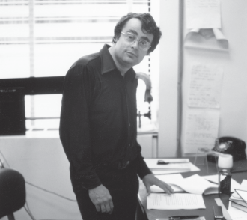
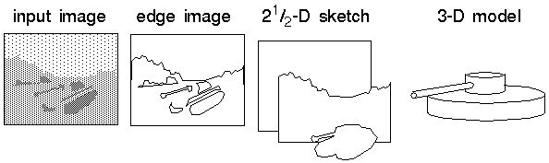
Computer Vision – a brief history
David Marr’s approach 1970-80s
Computation
Algorithm
Implementation
primal sketch and 2 ½ D sketch,
Notes:
David Marr, visual models grounded in psycho-physics

Slide 4
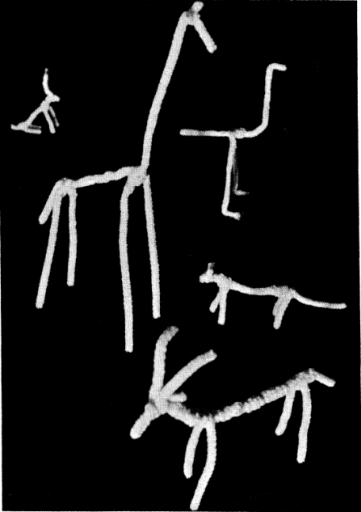
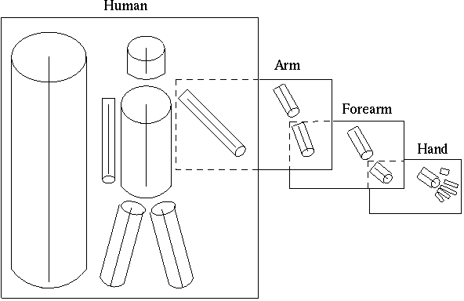
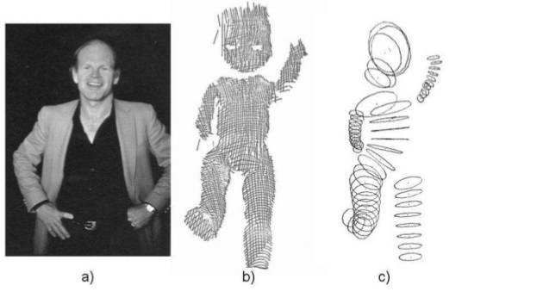
Computer Vision - Shape description
Skeletons and Cylinders: Marr and Nishihara 1978:
Tom Binford, generalized cylinders 1971
Notes:
World-centered representations

Slide 5
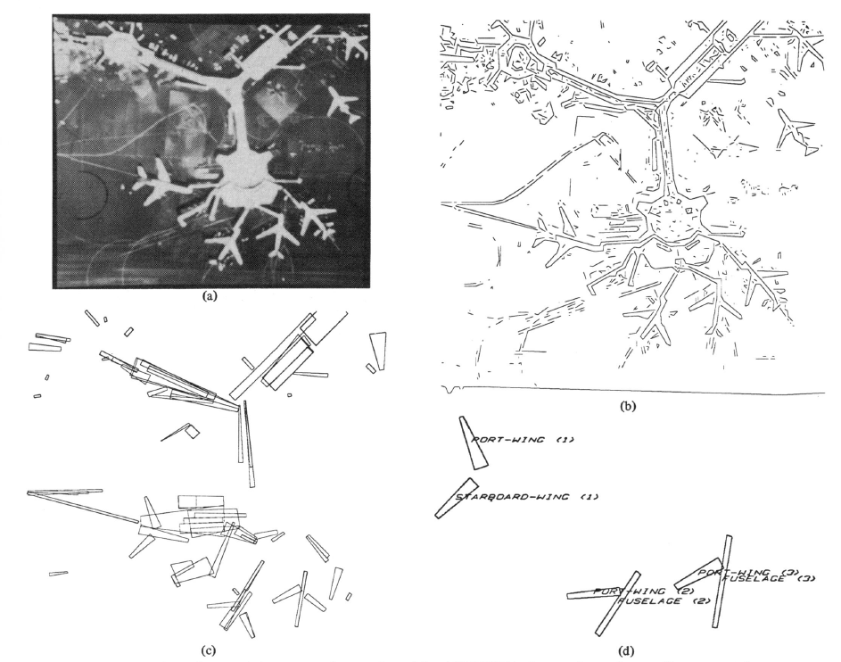
Computer Vision - Shape matching
ACRONYM (Brooks 1982) matching with generalized cylinders + search!:
Notes:
Arguably realizes the Marr pipeline

Slide 6
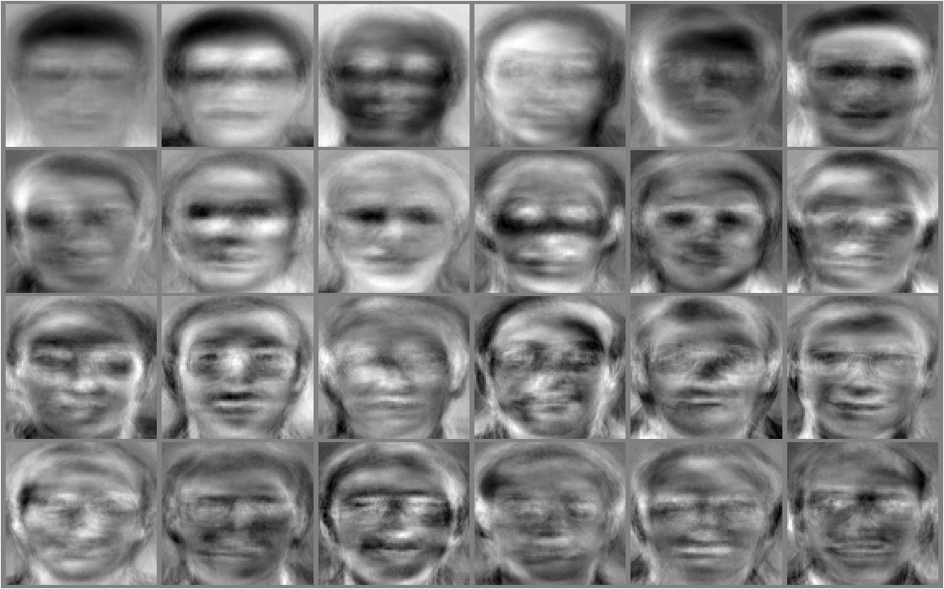
Computer Vision - Eigenfaces
Turk and Pentland 1991:
A data-driven approach?
Notes:
Works when you have lots of views of each face, leverages fast computation (matrix algebra)

Slide 7
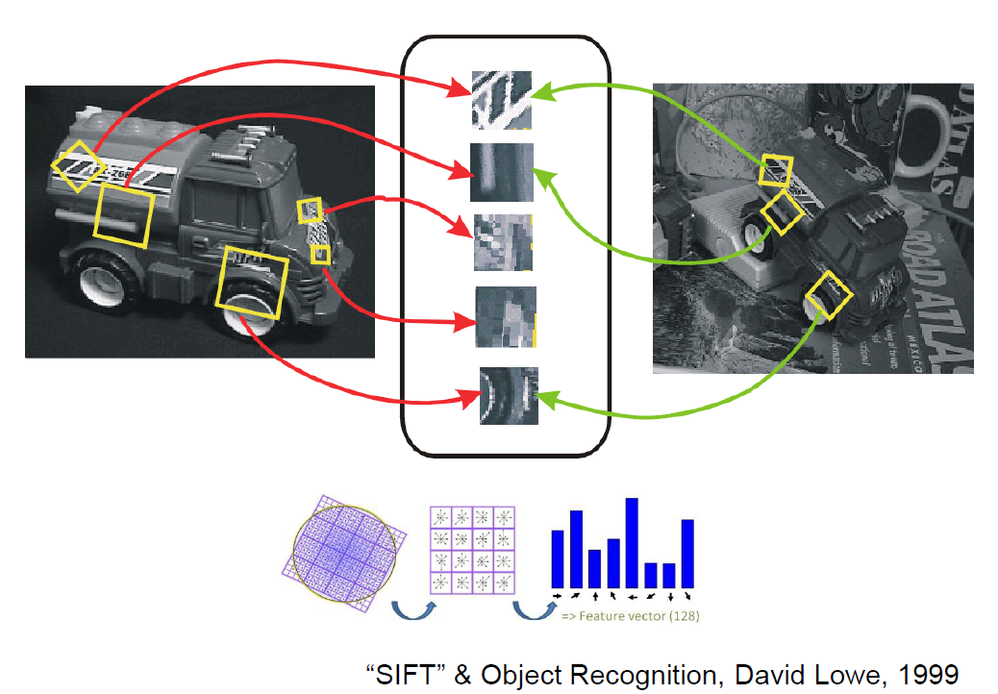
Computer Vision – Invariant Features

Slide 8
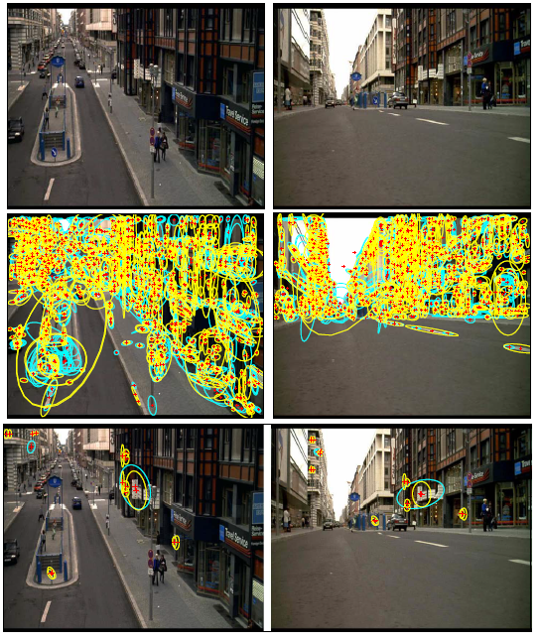
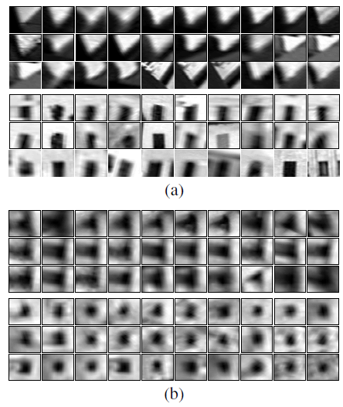
Computer Vision – Bag-of-words
Sivic and Zisserman (2003) “Video Google: A Text Retrieval Approach to Object Matching in Videos”
SIFT → SA and MS regions code words
Notes:
区域提取在灰度图中实现的，没用到图像的色彩信息，并且一帧图像中提取出的区域要和相邻几帧进行比较，若该区域只出现在当前一帧图像上，就会把该区域当成噪声或不稳定区域舍去。有了visual words之后便要构造相应的字典（visual vocabulary），这里是将文章中提到的两部视频按48个镜头大约10000帧的图像进行visual words的提取，然后将提取到的visual words用K-means的方法进行聚类，得到一副词典，这样每帧图像我们就可以像文字检索中的一篇文档那样，用词典中相关词的频率来描述。这里作者提到了关于SA和MS区域两种描述子的聚类过程是相互独立的。

Slide 9
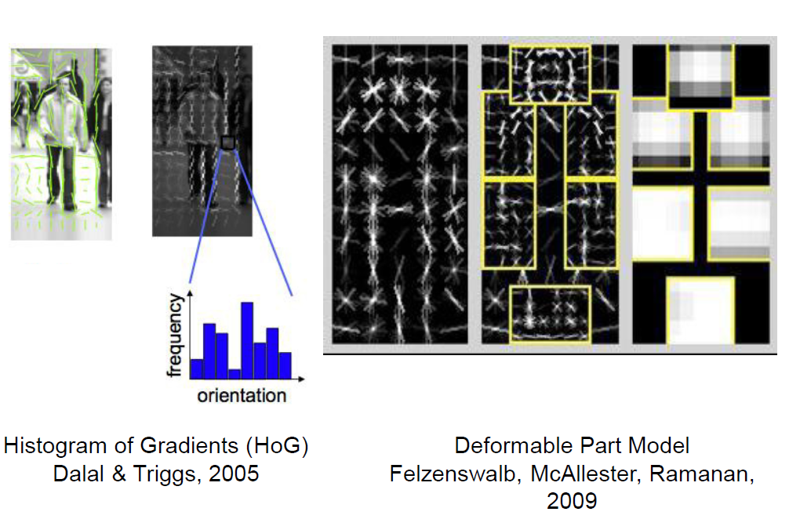
Computer Vision - Shape matching
Notes:
DPM（Deformable Part Model可变形的组件模型，是一种基于组件的检测算法。该模型由大神Felzenszwalb在2008年提出，并发表了一系列的cvpr，NIPS。并且还拿下了2010年，PASCAL VOC的“终身成就奖”。

Slide 10
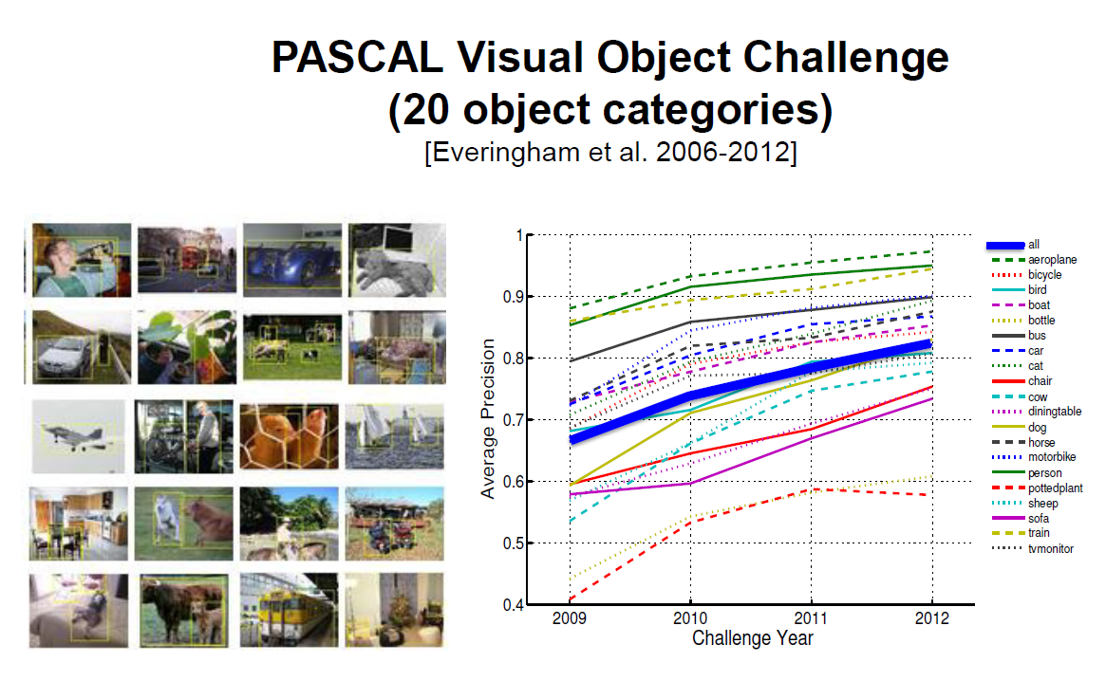
Computer Vision – Challenge Datasets

Slide 11
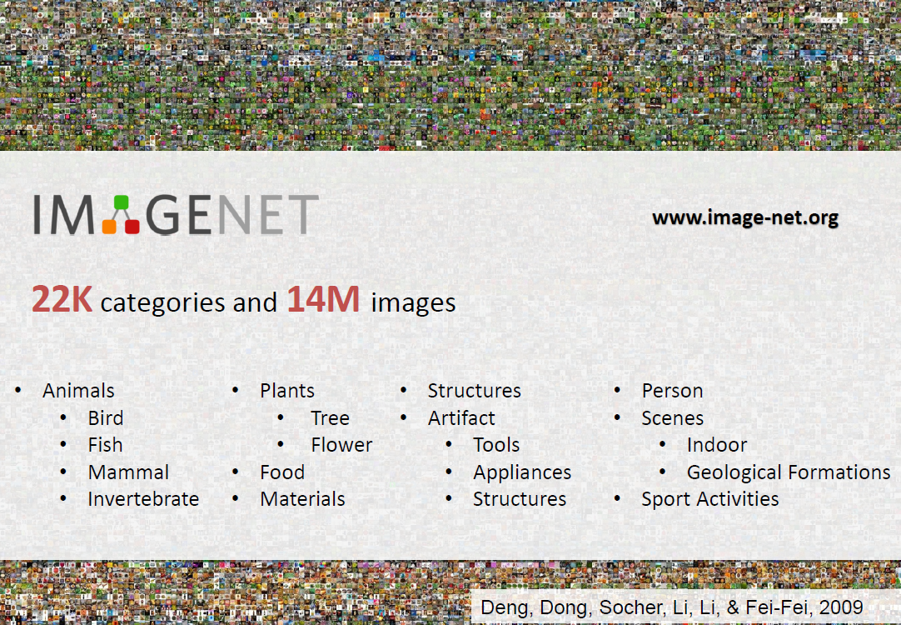
Computer Vision – Deep Networks

Slide 12
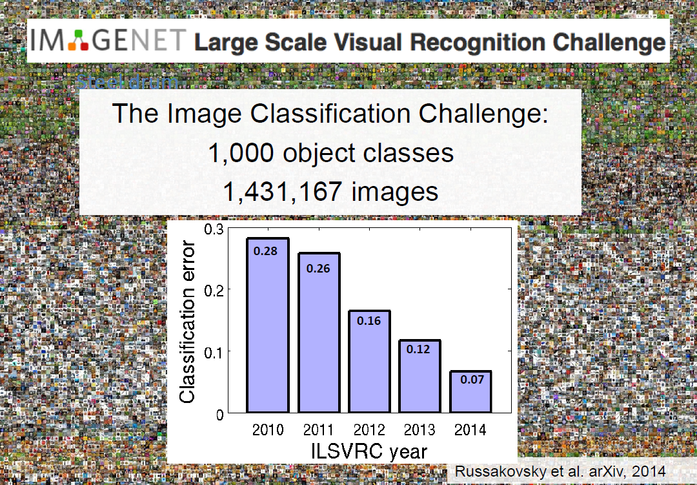
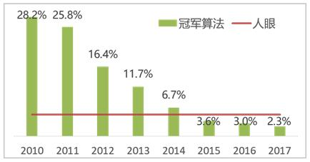
Computer Vision – Deep Networks
Notes:
Human 5.1%

Slide 13
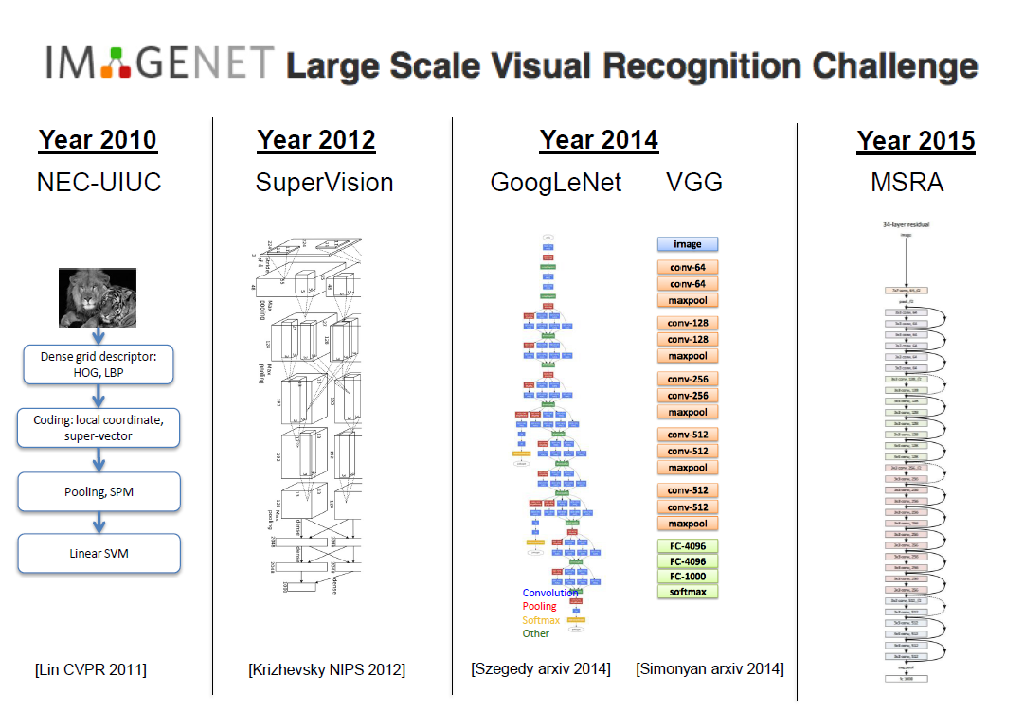
Computer Vision – Deep Networks

Slide 14
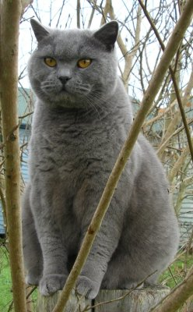
Image Classification: a core task in Computer Vision
(assume given set of discrete labels)
{dog, cat, truck, plane, ...}
cat
Notes:
图像分类的流程

Slide 15

The problem:semantic gap
Images are represented as 3D arrays of numbers, with integers between [0, 255].
E.g.
300 x 100 x 3
(3 for 3 color channels RGB)

Slide 16
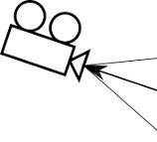
Challenges: Viewpoint Variation

Slide 17
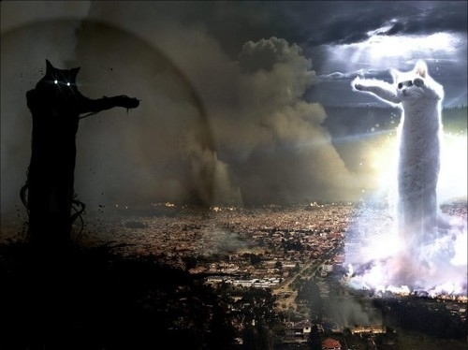
Challenges: Illumination

Slide 18
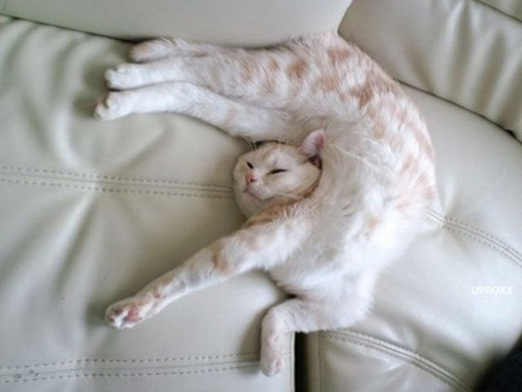
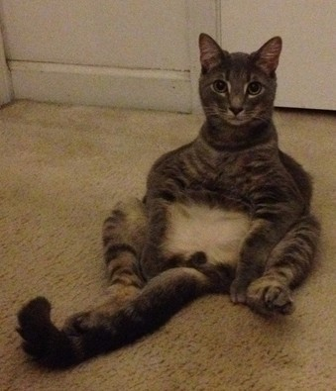
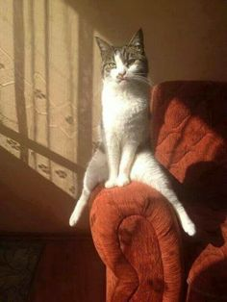
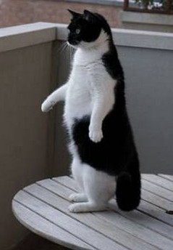
Challenges: Deformation

Slide 19
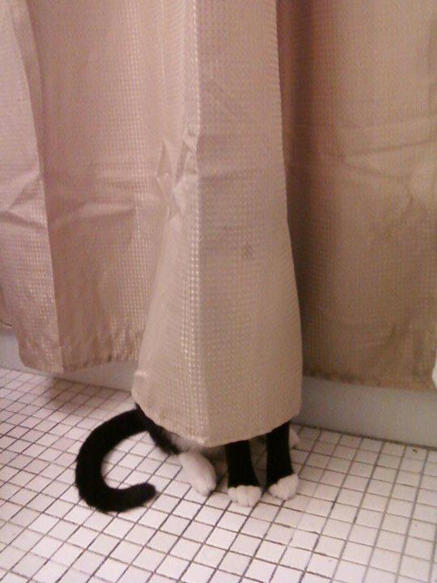
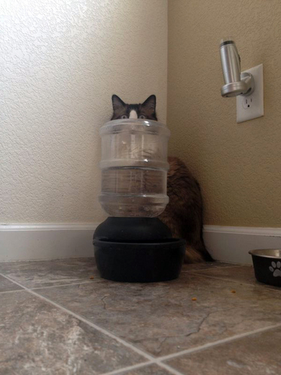
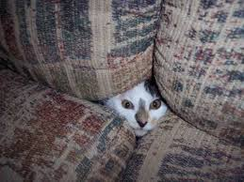
Challenges: Occlusion

Slide 20
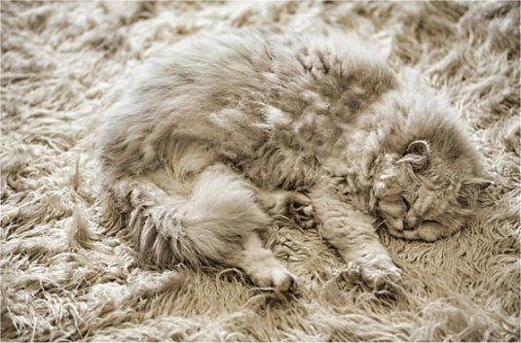
Challenges: Background clutter

Slide 21
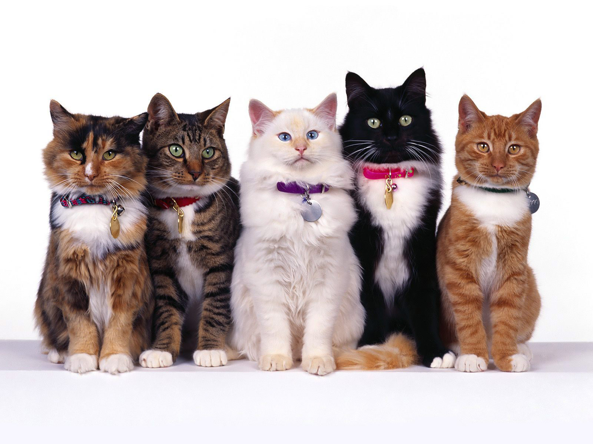
Challenges: Intraclass variation

Slide 22
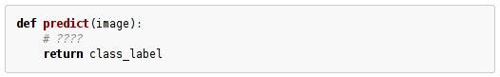
An image classifier
Unlike e.g. sorting a list of numbers,
no obvious way to hard-code the algorithm for recognizing a cat, or other classes.

Slide 23
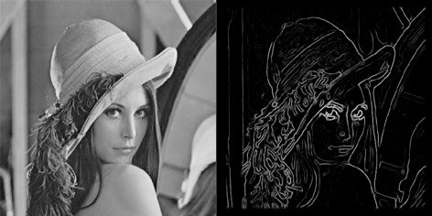
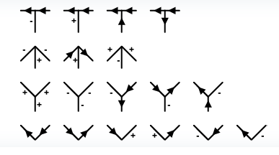
Classifying using constraints? ?
???
Notes:
手工找特征

Slide 24
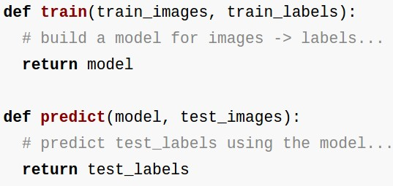
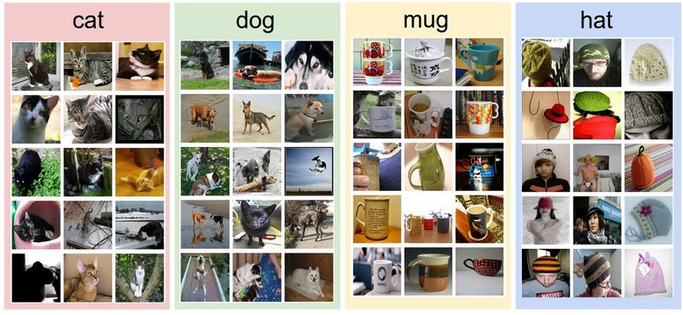
Collect a dataset of images and labels
Use Machine Learning to train an image classifier
Evaluate the classifier on a withheld set of test images
Data-driven approach:
Example training set

Slide 25
First classifier: Nearest Neighbor Classifier
Remember all training images and their labels
Predict the label of the most similar training image

Slide 26
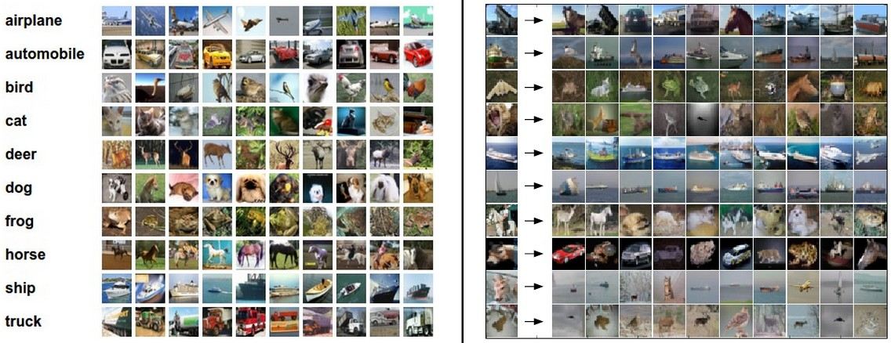
Example dataset: CIFAR-10
10 labels
50,000 training RGB images, each image is tiny: 32x32
10,000 test images.
Notes:
Alex提出

Slide 27
Example dataset: CIFAR-10
10 labels
50,000 training images
10,000 test images.
For every test image (first column), examples of nearest neighbors in rows

Slide 28
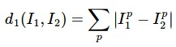
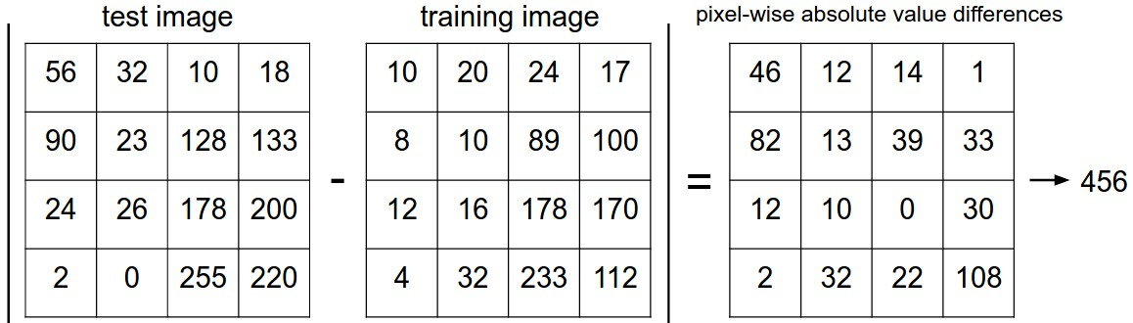
How do we compare the images?
What is the distance metric?
L1 distance:
add

Slide 29
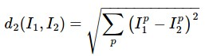
The choice of distance is a hyperparameter
common choices:
L1 (Manhattan) distance
L2 (Euclidean) distance

Slide 30
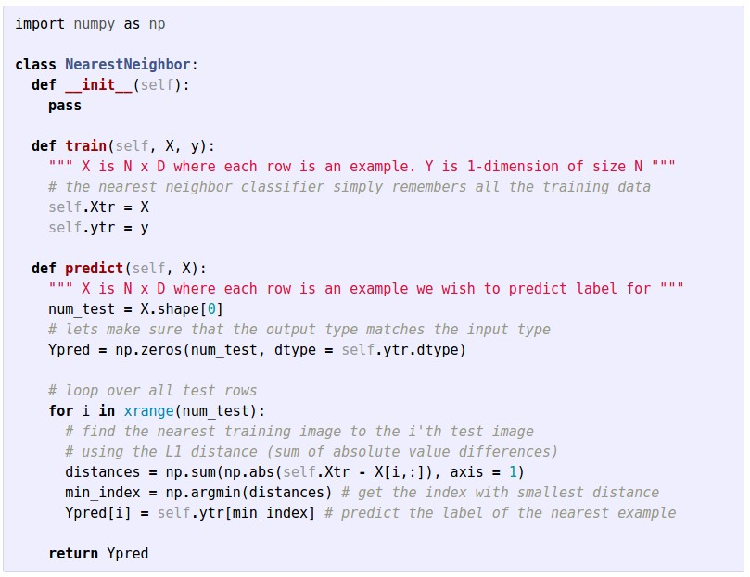
Nearest Neighbor classifier
Numpy：http://www.numpy.org.cn/article/basics/python_numpy_tutorial.html

Slide 31
Nearest Neighbor classifier
remember the training data

Slide 32
Nearest Neighbor classifier
for every test image:
find nearest train image with L1 distance
predict the label of nearest training image

Slide 33
Nearest Neighbor classifier
Q: how does the classification speed depend on the size of the training data?

Slide 34
Nearest Neighbor classifier
Q: how does the classification speed depend on the size of the training data? linearly :(
This is backwards:
- test time performance is usually much more important in practice.
- CNNs flip this: expensive training, cheap test evaluation

Slide 35
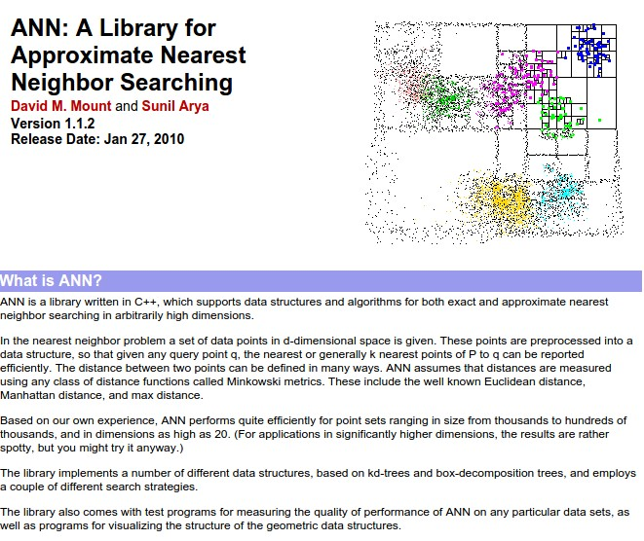
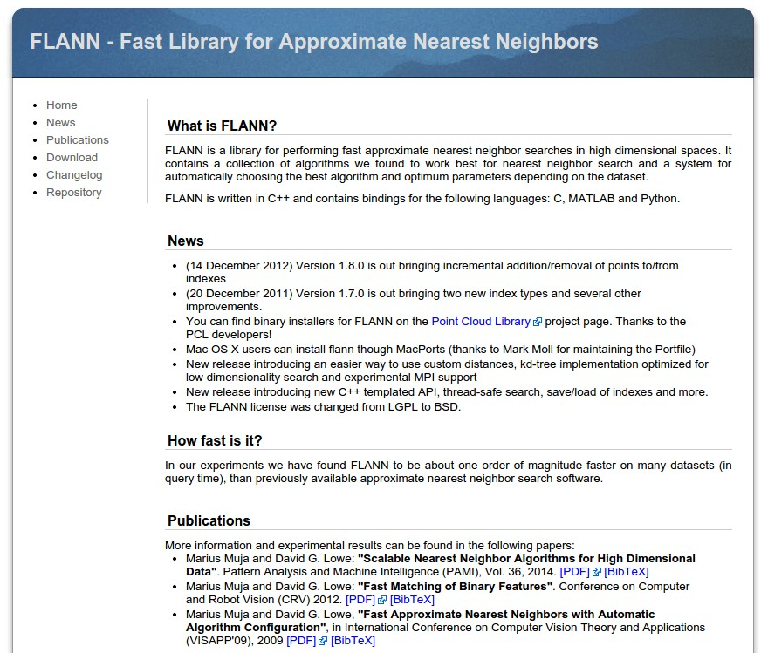
Aside: Approximate Nearest Neighbor
find approximate nearest neighbors quickly

Slide 36

k-Nearest Neighbor
find the k nearest images, have them vote on the label

Slide 37
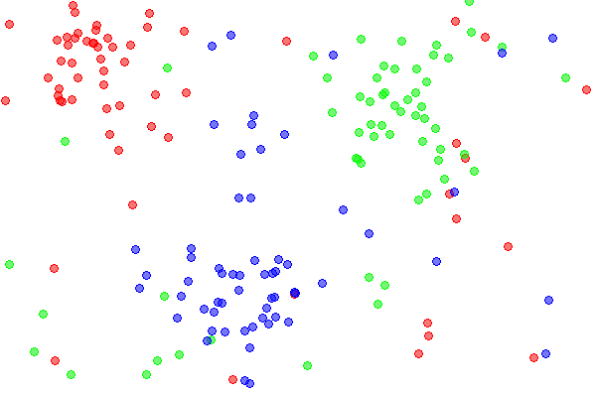
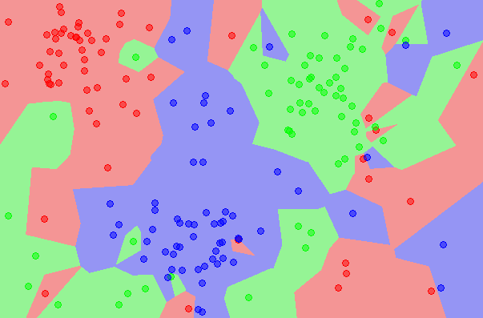
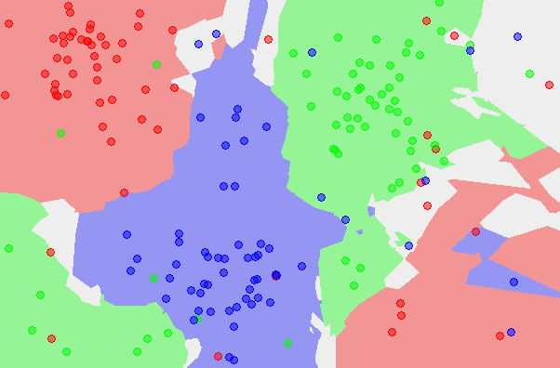
k-Nearest Neighbor
find the k nearest images, have them vote on the label
the data
NN classifier
5-NN classifier
vision.stanford.edu/teaching/cs231n-demos/knn/
http://en.wikipedia.org/wiki/K-nearest_neighbors_algorithm

Slide 38
Example dataset: CIFAR-10
10 labels
50,000 training images
10,000 test images.
For every test image (first column), examples of nearest neighbors in rows

Slide 39
the data
NN classifier
5-NN classifier
Q: what is the accuracy of the nearest neighbor classifier on the training data, when using the Euclidean distance?

Slide 40
the data
NN classifier
5-NN classifier
Q2: what is the accuracy of the k-nearest neighbor classifier on the training data?

Slide 41
k值设置过小会降低分类精度；若设置过大且测试样本属于训练集中包含数据较少的类，则会增加噪声，降低分类效果

Slide 42
Hyperparameter tuning:
What is the best distance to use?
What is the best value of k to use?
i.e. how do we set the hyperparameters?
Notes:
在实际应用中，K先取一个比较小的数值，再采用交叉验证法来逐步调整K值，最终选择适合该样本的最优的K值
经验规则：k一般低于训练样本数的平方根

Slide 43
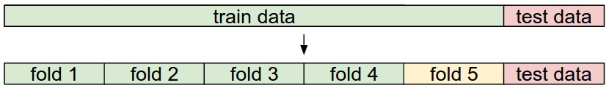
Try out what hyperparameters work best on test set.

Slide 44
Trying out what hyperparameters work best on test set:
Very bad idea. The test set is a proxy for the generalization performance!
Use only VERY SPARINGLY, at the end.

Slide 45
Validation Set:
Validation data
use to tune hyperparameters

Slide 46
Validation Set:
K-fold cross validation
Cross-validation
cycle through the choice of which fold is the validation fold, average results.
Notes:
K-fold cross validation K越大，每次投入的训练集的数据越多，模型的Bias越小。但是K越大，又意味着每一次选取的训练集之前的相关性越大（考虑最极端的例子，当k=N，也就是在LOOCV里，每次都训练数据几乎是一样的）。而这种大相关性会导致最终的test error具有更大的Variance。

Slide 47
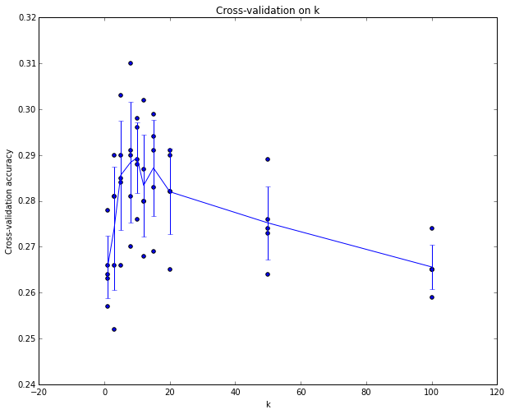
Hyperparameter tuning:
Example of
5-fold cross-validation
for the value of k（nearest ）.
Each point: single
outcome.
The line goes
through the mean, bars
indicated standard
deviation
(Seems that k ~= 7 works best
for this data)

Slide 48
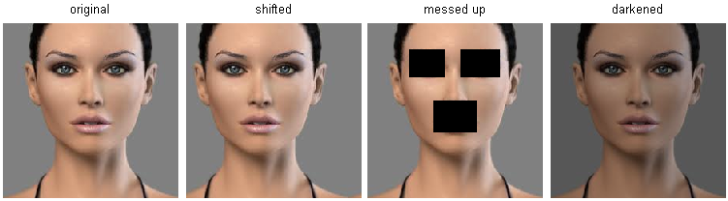
k-Nearest Neighbor on images never used.
WHY?
terrible performance at test time
distance metrics on level of whole images can be very unintuitive
(all 3 images have same L2 distance to the one on the left)

Slide 49
Notes:
背景带来了大量的干扰，如何学习到主体部分。

Slide 50
Summary
Image Classification: given a Training Set of labeled images, predict labels on Test Set. Common to report the Accuracy of predictions (fraction of correct predictions)
We introduced the k-Nearest Neighbor Classifier, which predicts labels based on nearest images in the training set
We saw that the choice of distance and the value of k are hyperparameters that are tuned using a validation set, or through cross-validation if the size of the data is small.
Once the best set of hyperparameters is chosen, the classifier is evaluated once on the test set, and reported as the performance of kNN on that data.

Slide 51
Linear Classification

Slide 52
Recall from last time… Challenges in Visual Recognition
Camera pose
Illumination
Deformation
Occlusion
Background clutter
Intraclass variation

Slide 53
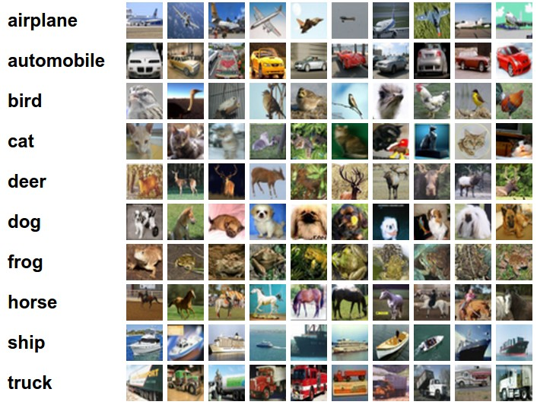
Recall from last time… data-driven approach, kNN
the data
NN classifier
5-NN classifier

Slide 54
Image Classification
CIFAR-10
10 labels
50,000 training images
each image is 32x32x3
10,000 test images.

Slide 55
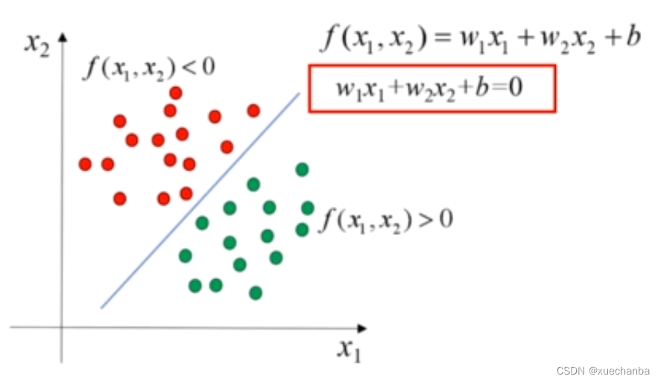
Linear Classification
Notes:
二维空间中，线性分类器就是一条直线

Slide 56
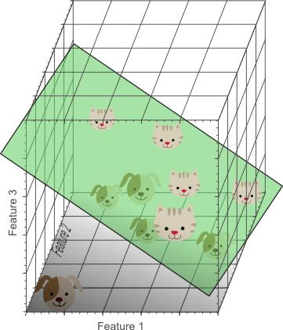
Linear Classification

Slide 57

Parametric approach
image
parameters
f(x,W)
10 numbers, indicating class scores
[32x32x3]
array of numbers 0...1
(3072 numbers total)
Notes:
输出图中内容的标签

Slide 58

Parametric approach: Linear classifier
10 numbers, indicating class scores
[32x32x3]
array of numbers 0...1

Slide 59
Parametric approach: Linear classifier
3072x1
10x1
10x3072
10 numbers, indicating class scores
[32x32x3]
array of numbers 0...1
parameters, or “weights”
Notes:
10行1列的矩阵，每一行都代表一种分类（10组分类），元素值的大小表示图片属于对应分类的可能性大小
w的结构：有10行，每一行都有图片被拉伸后的元素个数

Slide 60
Parametric approach: Linear classifier
3072x1
(+b)
10x1
10x1
10x3072
10 numbers, indicating class scores
[32x32x3]
array of numbers 0...1
parameters, or “weights”
Notes:
对于图像中的每一个点，对于点对应的每一个类别，都有一个权重值
对于每一个类别，都通过图像中所有点与其对应的权重值的乘积计算之后得到

Slide 61

Example image with 4 pixels, and 3 classes (cat/dog/ship)
Notes:
代数解释：权重参数中有正有负，负代表对某种分类的决策有抑制作用

Slide 62

Interpreting a Linear Classifier
Q: what does the linear classifier do?

Slide 63

Interpreting a Linear Classifier
Example trained weights of a linear classifier trained on CIFAR-10:
Notes:
可视化解释：每个类的权重图

Slide 64


矩阵W的马（左图）和船（右图）分类可视化
Notes:
将矩阵W缩放到0至255区间，将矩阵W对应的horse马分类和ship船分类的那一行提取出来；然后将其进行图片可视化，

Slide 65

Interpreting a Linear Classifier
[32x32x3]
array of numbers 0...1
(3072 numbers total)
Notes:
几何解释：w确定斜率，b确定与y轴的交点，每条直线分一个类别

Slide 66

Notes:
线性分类器的缺点

Slide 67


Going forward: Loss functions/optimization
TODO:
Define a loss function that quantifies our unhappiness with the scores across the training data.
Come up with a way of efficiently finding the parameters that minimize the loss function. (optimization)
-3.45
-8.87
0.09
2.9
4.48
8.02
3.78
1.06
-0.36
-0.72
-0.51
6.04
5.31
-4.22
-4.19
3.58
4.49
-4.37
-2.09
-2.93
3.42
4.64
2.65
5.1
2.64
5.55
-4.34
-1.5
-4.79
6.14
Notes:
怎么确定权重是否好？损失函数是一种衡量损失和错误程度的函数

Slide 68

Loss functions
Suppose: 3 training examples, 3 classes.
For some W the scores $f\left(x,W\right)=Wx$are:
cat
3.2
1.3
2.2
car
5.1
4.9
2.5
frog
-1.7
2.0
-3.1

Slide 69


Multiclass SVM loss:
Suppose: 3 training examples, 3 classes.
For some W the scores $f\left(x,W\right)=Wx$ are:
Given an example$\left(x_{i},y_{i}\right)$
where $x_{i}$ is the image and
where $y_{i}$ is the (integer) label,
and using the shorthand for the scores vector:
$$s=f\left(x_{i},W\right)$$
the SVM loss has the form:
$$L_{i}=\sum_{j≠y_{i}}{max\left(0,s_{j}−s_{y_{i}}+\text{∆}\right)}$$
∆=1
cat
3.2
1.3
2.2
car
5.1
4.9
2.5
frog
-1.7
2.0
-3.1
Notes:
公式中的加1表示容忍程度

Slide 70


Multiclass SVM loss:
Suppose: 3 training examples, 3 classes.
For some W the scores $f\left(x,W\right)=Wx$ are:
Given an example$\left(x_{i},y_{i}\right)$
where $x_{i}$ is the image and
where $y_{i}$ is the (integer) label,
and using the shorthand for the scores vector:
$$s=f\left(x_{i},W\right)$$
the SVM loss has the form:
$$L_{i}=\sum_{j≠y_{i}}{max\left(0,s_{j}−s_{y_{i}}+1\right)}$$
= max(0, 5.1 - 3.2 + 1)
+max(0, -1.7 - 3.2 + 1)
= max(0, 2.9) + max(0, -3.9)
= 2.9 + 0
= 2.9
cat
3.2
1.3
2.2
car
5.1
4.9
2.5
frog
-1.7
2.0
-3.1
Losses:
2.9

Slide 71

Multiclass SVM loss:
Suppose: 3 training examples, 3 classes.
For some W the scores $f\left(x,W\right)=Wx$ are:
Given an example$\left(x_{i},y_{i}\right)$
where $x_{i}$ is the image and
where $y_{i}$ is the (integer) label,
and using the shorthand for the scores vector:
$$s=f\left(x_{i},W\right)$$
the SVM loss has the form:
$$L_{i}=\sum_{j≠y_{i}}{max\left(0,s_{j}−s_{y_{i}}+1\right)}$$
= max(0, 1.3 - 4.9 + 1)
+max(0, 2.0 - 4.9 + 1)
= max(0, -2.6) + max(0, -1.9)
= 0 + 0
= 0
cat
3.2
1.3
2.2
car
5.1
4.9
2.5
frog
-1.7
2.0
-3.1
Losses:
2.9
0

Slide 72

Multiclass SVM loss:
Suppose: 3 training examples, 3 classes.
For some W the scores $f\left(x,W\right)=Wx$ are:
Given an example$\left(x_{i},y_{i}\right)$
where $x_{i}$ is the image and
where $y_{i}$ is the (integer) label,
and using the shorthand for the scores vector:
$$s=f\left(x_{i},W\right)$$
the SVM loss has the form:
$$L_{i}=\sum_{j≠y_{i}}{max\left(0,s_{j}−s_{y_{i}}+1\right)}$$
= max(0, 2.2 - (-3.1) + 1)
+max(0, 2.5 - (-3.1) + 1)
= max(0, 5.3) + max(0, 5.6)
= 5.3 + 5.6
= 10.9
cat
3.2
1.3
2.2
car
5.1
4.9
2.5
frog
-1.7
2.0
-3.1
Losses:
2.9
0
10.9

Slide 73

Multiclass SVM loss:
Suppose: 3 training examples, 3 classes.
For some W the scores $f\left(x,W\right)=Wx$ are:
Given an example$\left(x_{i},y_{i}\right)$
where $x_{i}$ is the image and
where $y_{i}$ is the (integer) label,
and using the shorthand for the scores vector:
$$s=f\left(x_{i},W\right)$$
the SVM loss has the form:
$$L_{i}=\sum_{j≠y_{i}}{max\left(0,s_{j}−s_{y_{i}}+1\right)}$$
and the full training loss is the mean over all the examples:
$$L=\frac{1}{N}\sum_{i=1}^{N}{L_{i}}$$
L = (2.9 + 0 + 10.9)/3 = 4.6
cat
3.2
1.3
2.2
car
5.1
4.9
2.5
frog
-1.7
2.0
-3.1
Losses:
2.9
0
10.9
Notes:
结果越大，模型效果越差，

Slide 74

Multiclass SVM loss:
Suppose: 3 training examples, 3 classes.
For some W the scores $f\left(x,W\right)=Wx$ are:
Given an example$\left(x_{i},y_{i}\right)$
where $x_{i}$ is the image and
where $y_{i}$ is the (integer) label,
and using the shorthand for the scores vector:
$$s=f\left(x_{i},W\right)$$
the SVM loss has the form:
$$L_{i}=\sum_{j≠y_{i}}{max\left(0,s_{j}−s_{y_{i}}+1\right)}$$
Q: what if the sum was instead over all classes?
(including j = y_i)
cat
3.2
1.3
2.2
car
5.1
4.9
2.5
frog
-1.7
2.0
-3.1
Losses:
2.9
0
10.9

Slide 75

Multiclass SVM loss:
Suppose: 3 training examples, 3 classes.
For some W the scores $f\left(x,W\right)=Wx$ are:
Given an example$\left(x_{i},y_{i}\right)$
where $x_{i}$ is the image and
where $y_{i}$ is the (integer) label,
and using the shorthand for the scores vector:
$$s=f\left(x_{i},W\right)$$
the SVM loss has the form:
$$L_{i}=\sum_{j≠y_{i}}{max\left(0,s_{j}−s_{y_{i}}+1\right)}$$
Q2: what if we used a mean instead of a sum here?
cat
3.2
1.3
2.2
car
5.1
4.9
2.5
frog
-1.7
2.0
-3.1
Losses:
2.9
0
10.9

Slide 76

Multiclass SVM loss:
Suppose: 3 training examples, 3 classes.
For some W the scores $f\left(x,W\right)=Wx$ are:
Given an example$\left(x_{i},y_{i}\right)$
where $x_{i}$ is the image and
where $y_{i}$ is the (integer) label, and using the shorthand for the scores vector:
$$s=f\left(x_{i},W\right)$$
the SVM loss has the form:
$$L_{i}=\sum_{j≠y_{i}}{max\left(0,s_{j}−s_{y_{i}}+1\right)}$$
Q3: what if we used a squared loss:
$$L_{i}=\sum_{j≠y_{i}}{{max\left(0,s_{j}−s_{y_{i}}+1\right)}^{2}}$$
cat
3.2
1.3
2.2
car
5.1
4.9
2.5
frog
-1.7
2.0
-3.1
Losses:
2.9
0
10.9
Notes:
放大损失，对坏得更敏感

Slide 77

Multiclass SVM loss:
Suppose: 3 training examples, 3 classes.
For some W the scores $f\left(x,W\right)=Wx$ are:
Given an example$\left(x_{i},y_{i}\right)$
where $x_{i}$ is the image and
where $y_{i}$ is the (integer) label, and using the shorthand for the scores vector:
$$s=f\left(x_{i},W\right)$$
the SVM loss has the form:
$$L_{i}=\sum_{j≠y_{i}}{max\left(0,s_{j}−s_{y_{i}}+1\right)}$$
Q4: what is the min/max possible loss?
cat
3.2
1.3
2.2
car
5.1
4.9
2.5
frog
-1.7
2.0
-3.1
Losses:
2.9
0
10.9

Slide 78

Multiclass SVM loss:
Suppose: 3 training examples, 3 classes.
For some W the scores $f\left(x,W\right)=Wx$ are:
Given an example$\left(x_{i},y_{i}\right)$
where $x_{i}$ is the image and
where $y_{i}$ is the (integer) label, and using the shorthand for the scores vector:
$$s=f\left(x_{i},W\right)$$
the SVM loss has the form:
$$L_{i}=\sum_{j≠y_{i}}{max\left(0,s_{j}−s_{y_{i}}+1\right)}$$
Q5: usually at initialization W are small numbers, so all $s≈0$ What is the loss?
cat
3.2
1.3
2.2
car
5.1
4.9
2.5
frog
-1.7
2.0
-3.1
Losses:
2.9
0
10.9

Slide 79


Example numpy code:
$$L_{i}=\sum_{j≠y_{i}}{max\left(0,s_{j}−s_{y_{i}}+1\right)}$$

Slide 80

$$f\left(x,W\right)=Wx$$
$$L=\frac{1}{N}\sum_{i=1}^{N}{\sum_{j≠y_{i}}{max\left(0, {f\left(x_{i},W\right)}_{j}−{f\left(x_{i},W\right)}_{y_{i}}+1\right)} }$$

Slide 81


There is a bug with the loss:
$$f\left(x,W\right)=Wx$$
$$L=\frac{1}{N}\sum_{i=1}^{N}{\sum_{j≠y_{i}}{max\left(0, {f\left(x_{i},W\right)}_{j}−{f\left(x_{i},W\right)}_{y_{i}}+1\right)} }$$

Slide 82

There is a bug with the loss:
$$f\left(x;W\right)=Wx$$
$$L=\frac{1}{N}\sum_{i=1}^{N}{\sum_{j≠y_{i}}{max\left(0, {f\left(x_{i},W\right)}_{j}−{f\left(x_{i},W\right)}_{y_{i}}+1\right)} }$$
E.g. Suppose that we found a W such that L = 0.
Is this W unique?

Slide 83


Multiclass SVM loss:
Suppose: 3 training examples, 3 classes.
For some W the scores $f\left(x,W\right)=Wx$ are:
$$L_{i}=\sum_{j≠y_{i}}{max\left(0,s_{j}−s_{y_{i}}+1\right)}$$
Original Car Image Loss:
= max(0, 1.3 - 4.9 + 1)
+max(0, 2.0 - 4.9 + 1)
= max(0, -2.6) + max(0, -1.9)
= 0 + 0
= 0
W twice as large:
= max(0, 2.6 - 9.8 + 1)
+max(0, 4.0 - 9.8 + 1)
= max(0, -6.2) + max(0, -4.8)
= 0 + 0
= 0
cat
3.2
1.3
2.2
car
5.1
4.9
2.5
frog
-1.7
2.0
-3.1
Losses:
2.9
0
10.9

Slide 84


Weight Regularization
$λ$= regularization strength
(hyperparameter)
$$L=\frac{1}{N}\sum_{i=1}^{N}{\sum_{j≠y_{i}}{max\left(0, {f\left(x_{i},W\right)}_{j}−{f\left(x_{i},W\right)}_{y_{i}}+1\right)}\text{+}λR\left(W\right) }$$
In common use:
L2 regularization $R\left(W\right)=\sum_{k}{\sum_{l}{W_{k,l}^{2}}}$
L1 regularization $R\left(W\right)=\sum_{k}{\sum_{l}{\left|W_{k,l}^{}\right|}}$
Elastic net (L1 + L2) $R\left(W\right)=β\sum_{k}{\sum_{l}{W_{k,l}^{2}+（1−β）\sum_{k}{\sum_{l}{\left|W_{k,l}^{}\right|}} }}$
Dropout (will see later)
Max norm regularization (might see later)
损失函数=数据损失+正则化惩罚项
Notes:
正则化损失R(W)并不是加在每个数据的损失上，而是加在所有一组训练集（N个数据）损失的平均值上
正则化的作用是提升分类器的泛化能力，每个损失函数都应该引入 λR(W)
真正的权衡是我们允许权重能够变大到何种程度（通过正则化强度λ来控制）

Slide 85

L2 regularization: motivation
$$x=\left[1,1,1,1\right]$$
$$w_{1}=\left[1,0,0,0\right]$$
$$w_{2}=\left[0.25,0.25,0.25,0.25\right]$$
$$w_{1}^{T}x=w_{2}^{T}x=1$$
What will L2 regularization do?
What will L1 regularization do?
Notes:
对于w1，只关注w1中的第一个像素点，而对于二号模型，w2的权重综合考虑了每一个像素点，都参与了计算。二号模型关注的面更广，而不至于过多关注某点而过拟合。所以我们需要得到类似的w2的分布稍显均匀的模型

Slide 86
Softmax Classifier (Multinomial Logistic Regression)
cat
3.2
car
5.1
frog
-1.7
Notes:
只要正确标签类别对应的得分syi比sj其他类别的得分多 ∆就可以得到0的结果；但如果syi比sj多更多，即远大于 ∆，则结果依旧也为0.SVM损失函数只关心这个W有多差，而不关心W有多优秀

Slide 87

Softmax Classifier (Multinomial Logistic Regression)
Scores = unnormalized log prob. of the classes
$s=f\left(x,W\right)$
cat
3.2
car
5.1
frog
-1.7

Slide 88

Softmax Classifier (Multinomial Logistic Regression)
Scores = unnormalized log prob. of the classes
$P\left(Y=k|X=x_{i}\right)=\frac{e^{s_{y_{i}}^{}}}{\sum_{j}{e^{s_{j}}}}$ where $s=f\left(x,W\right)$
cat
3.2
car
5.1
frog
-1.7

Slide 89
Softmax Classifier (Multinomial Logistic Regression)
Scores = unnormalized log prob. of the classes
$P\left(Y=k|X=x_{i}\right)=\frac{e^{s_{y_{i}}^{}}}{\sum_{j}{e^{s_{j}}}}$ where $s=f\left(x,W\right)$
3.2
Softmax function
cat
car
5.1
frog
-1.7
Notes:
Softmax函数接收一组评分输出s（有正有负），对每个评分s_{k}进行指数化确保正数，分母是所有评分指数化的和，分子是某个评分指数化后的值，这样就起到了归一化的作用。某个类的分值越大，指数化后越大，函数输出越接近于1，可以把输出看做该类别的概率值，所有类别的概率值和为一。如果正确类别的概率值越接近0，则该模型越糟

Slide 90

Softmax Classifier (Multinomial Logistic Regression)
Scores = unnormalized log prob. of the classes
$P\left(Y=k|X=x_{i}\right)=\frac{e^{s_{y_{i}}^{}}}{\sum_{j}{e^{s_{j}}}}$ where $s=f\left(x,W\right)$
Want to maximize the log likelihood, or (for a loss function) to minimize the negative log likelihood of the correct class:
$$L_{i}=−\log{P\left(Y=y_{i}|X=x_{i}\right)}$$
cat
3.2
car
5.1
frog
-1.7

Slide 91

Softmax Classifier (Multinomial Logistic Regression)
Scores = unnormalized log prob. of the classes
$P\left(Y=k|X=x_{i}\right)=\frac{e^{s_{y_{i}}^{}}}{\sum_{j}{e^{s_{j}}}}$ where $s=f\left(x,W\right)$
Want to maximize the log likelihood, or (for a loss function) to minimize the negative log likelihood of the correct class:
$$L_{i}=−\log{P\left(Y=y_{i}|X=x_{i}\right)}$$
In summary:
$$L_{i}=−\text{log}\left(\frac{e^{s_{y_{i}}^{}}}{\sum_{j}{e^{s_{j}}}}\right)$$
cat
3.2
car
5.1
frog
-1.7
cross-entropy loss
交叉熵损失

Slide 92

Softmax Classifier (Multinomial Logistic Regression)
$$L_{i}=−\text{log}\left(\frac{e^{s_{y_{i}}^{}}}{\sum_{j}{e^{s_{j}}}}\right)$$
cat
3.2
car
5.1
-1.7
frog
unnormalized log probabilities

Slide 93
Softmax Classifier (Multinomial Logistic Regression)
$$L_{i}=−\text{log}\left(\frac{e^{s_{y_{i}}^{}}}{\sum_{j}{e^{s_{j}}}}\right)$$
unnormalized probabilities
cat
3.2
24.5
exp
car
5.1
164.0
-1.7
0.18
frog
unnormalized log probabilities

Slide 94

Softmax Classifier (Multinomial Logistic Regression)
$$L_{i}=−\text{log}\left(\frac{e^{s_{y_{i}}^{}}}{\sum_{j}{e^{s_{j}}}}\right)$$
unnormalized probabilities
cat
3.2
24.5
0.13
$$L_{i}=−log⁡\left(0.13\right)$$
= 0.89
exp
normalize
car
5.1
164.0
0.87
-1.7
0.18
0.00
frog
unnormalized log probabilities
probabilities

Slide 95


Softmax Classifier (Multinomial Logistic Regression)
Q: What is the min/max possible $L_{i}$ ?
$$L_{i}=−\text{log}\left(\frac{e^{s_{y_{i}}^{}}}{\sum_{j}{e^{s_{j}}}}\right)$$
$$0，∞$$
unnormalized probabilities
cat
3.2
24.5
0.13
$$L_{i}=−log⁡\left(0.13\right)$$
= 0.89
exp
normalize
car
5.1
164.0
0.87
-1.7
0.18
0.00
frog
unnormalized log probabilities
probabilities

Slide 96



Softmax Classifier (Multinomial Logistic Regression)
$$L_{i}=−\text{log}\left(\frac{e^{s_{y_{i}}^{}}}{\sum_{j}{e^{s_{j}}}}\right)$$
unnormalized probabilities
cat
3.2
24.5
0.13
$$L_{i}=−log⁡\left(0.13\right)$$
= 0.89
exp
normalize
car
5.1
164.0
0.87
Q3: usually at initialization W are small numbers, so all s ≈ 0. What is the loss?
-1.7
0.18
0.00
frog
unnormalized log probabilities
probabilities

Slide 97


Slide 98


Softmax vs. SVM

Slide 99

Softmax vs. SVM
assume scores:
[10, -2, 3]
[10, 9, 9]
[10, -100, -100]
and
Q: Suppose I take a datapoint and I jiggle a bit (changing its score slightly). What happens to the loss in both cases?
Notes:
对于SVM损失，它关心的是边界区分。但对于交叉熵损失，由于正确类别的概率与分数间的差异是有关的，损失不可能等于0，正确类别的得分无穷大，其他得分无穷小，损失才趋于0。换句话说，交叉熵损失永远有缩小的空间，它希望评分模型完美；而SVM损失只需要评分模型好到一定程度就行了。
通常说来，两种损失函数的表现差别很小，大可不必纠结使用哪个

Slide 100
Note：Deep Learning using Linear Support Vector Machines
Multiclass SVM optimization demo (stanford.edu)

Slide 101
Summary
Linear classifiers: The simplest parametric classifier.
You must define a loss function in order to optimize the weights of a linear classifier. We first described SVM loss.
Certain loss functions (esp. SVM loss) underconstrain the model parameters. Regularization can fix this.
To produce a continuous prediction (probability of class membership) we described the softmax loss.
Finally we explored these methods with an interactive visualization.

